Slide 1

Game Design
COMP4451 Game Programming

Slide 2
Overview
The Design Theory
- To reflect as you make up your idea
II. The Design Process
- Make up your idea
The Design Production
- Realize your idea
Think about your game proposal!

Slide 3
I. The Design Theory
Previous lecture:
Game Category
Game Platform
Game Mechanics

Slide 4
I. The Design Theory
Now…… More game design issues
Game Structure: Linear VS Sandbox
Single-player VS Multiplayer
Realism VS Abstraction
2D VS 3D Games
1st VS 3rd person
Difficulty curves

Slide 5
Game Structure: Linear VS Sandbox
Linear
Games that have a single path to follow
Linear games have explicit goals that the player must achieve so as to progress: level 1, level 2, etc.
Usually has a clear and defined narrative sequence, like watching movies or dramas
E.g., Resident Evil 4, and most RPG games, etc.

Slide 6
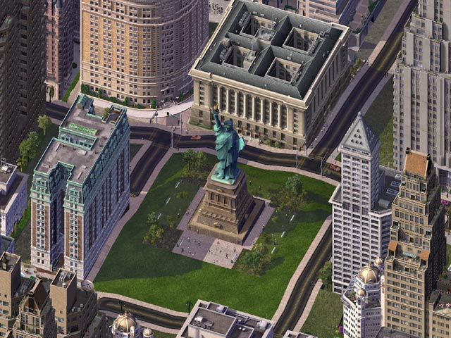
Game Structure: Linear VS Sandbox
Sandbox (Non-linear)
More freedom – players can approach challenges in more or less any order
Sometimes, sandbox games are open-ended
E.g., Sim City (most
simulation games), etc.

Slide 7
Game Structure: Linear VS Sandbox
Why Linear?
Easier to produce and control (by the game designers); hence lower the production cost
Why Sandbox?
More freedom could bring more fun
Designers have to handle all possibilities in games in the game design
Mixture: Linear in small quests
e.g., Legend of Zelda: The Windwaker, etc.

Slide 8
Single-player VS Multiplayer
Single-player
A player competes or cooperates with non-player characters (NPC) and objects controlled by the computer
Multiplayer
A player plays against or with other human players, either on the same computer, a LAN, or the Internet

Slide 9
Single-player VS Multiplayer
Designing a single-player game
Focus of the game designer is to entertain the player
The designer can create unbalanced opponents (the player’s enemies) controllable by the computer
Usually requires AI for the control
Need to make up an exciting game world and opponents

Slide 10
Single-player VS Multiplayer
Designing a multiplayer game
Fairness: all players are created to have relatively equal ability / tools
Relatively, require less AI
More development time on the networking and game performance

Slide 11
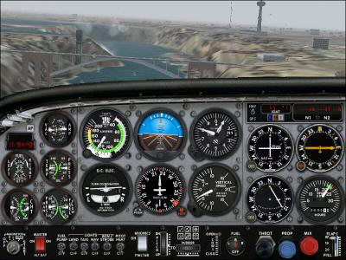
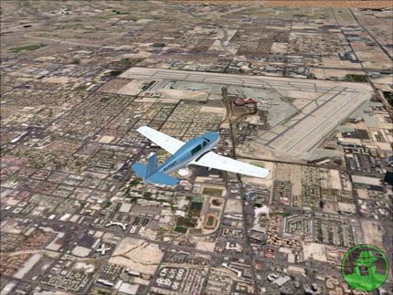
Realism VS Abstraction
This is the presentation of the game, typically:
Realism games
First-person shooting, simulation games, god games, etc.
e.g., Microsoft Flight Simulator, Civilization, etc.
Usually more computation and graphics rendering power

Slide 12
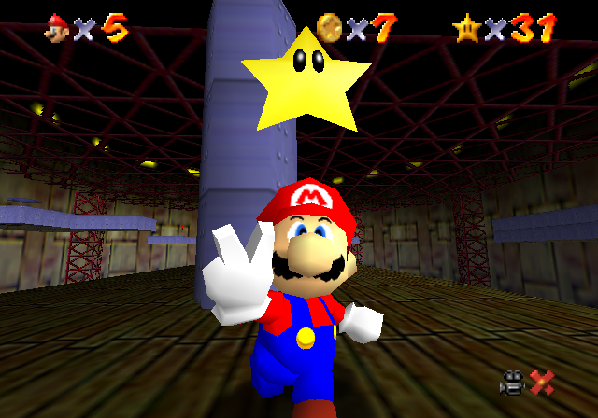
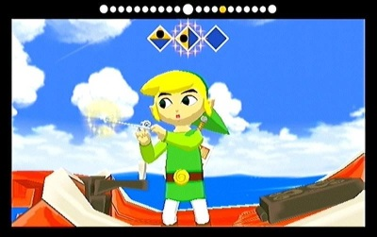
Realism VS Abstraction
Abstract games
Inviting players to enter cartoon/surreal/dream worlds
Does not rely on a representation of the real-world
Common in RPG games like:
e.g., Mario Bros., Legend of Zelda, etc.

Slide 13
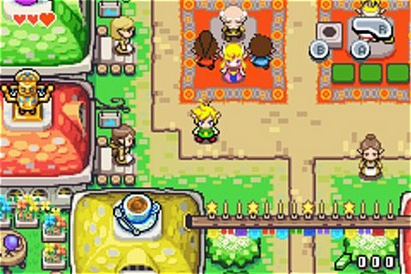
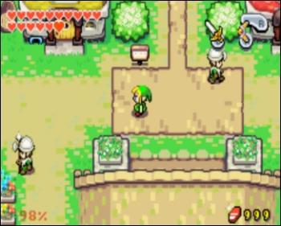
2D VS 3D Games
What is a 2D game?
All actions and activities work in two-dimensions
Using only 2D graphics and 2D camera movement
e.g., most old games, Zelda: The Minish Cap

Slide 14
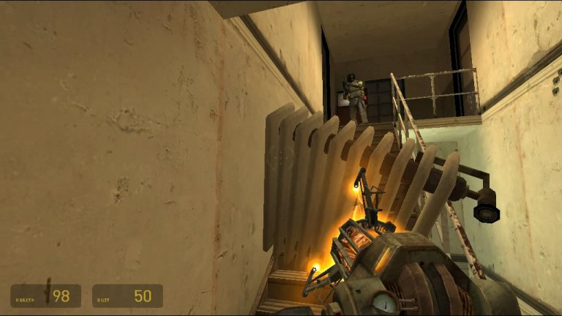
2D VS 3D Games
What is a 3D game?
Takes place in three-dimensions with 3D movements
The Role of camera is very important in 3D games:
how to place and how to control the camera so that it does
not interfere with the players’ actions, but also allow
the player to see
what he/she wanted
e.g., Half Life 2

Slide 15
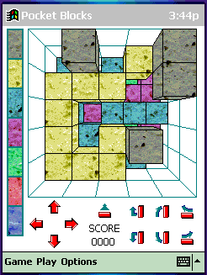
2D VS 3D Games
Transitions from 2D to 3D
Some successful 2D games have been transitioned to 3D, e.g.,
Mario, Zelda, etc.
Two major challenges:
Navigation control in 3D
(moving in the 3D world)
Camera Control
Unsuccessful case: 3D Tetris

Slide 16
First-Person VS Third-Person
It describes how we see the game world
First-Person view
As if we see the game world through our game character
Third-Person view
View the game world at a distance from the game character
Second-Person view
Seldom used in games: We see the game world through other character in the game world

Slide 17
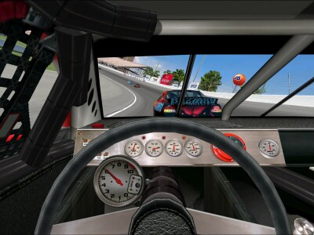
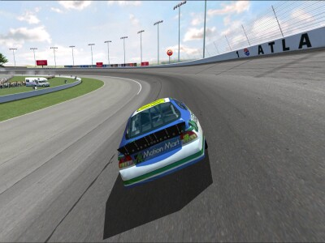
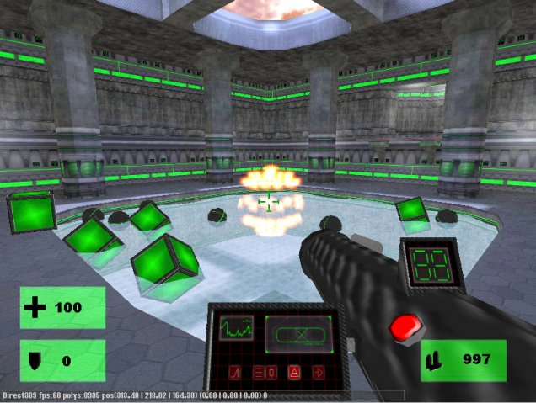
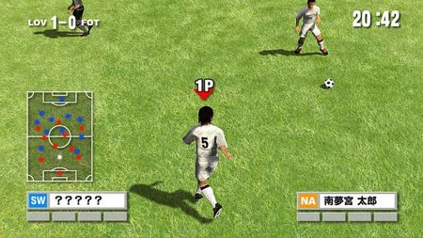
First-person view
Third-person view

Slide 18
First-Person VS Third-Person
Advantages and disadvantages:
First-Person view
More immersive feeling, more excitement
The game character is not visible and makes players hard to perceive the whole world; game players need to switch to other view modes or need to see mini-maps constantly
Third-Person view
Less immersive feeling
Allows players to clearly see the entire game world
Or delivers both views in your game?

Slide 19
Difficulty Curves
How to setup the level of difficulty in a game?
General rule:
Start Easy and End Hard
Why?
At the beginning, players need to learn possible moves of
his/her game character or the rules in the games

Slide 20
Difficulty Curves
More…
Some game designers will introduce dips (no change in
difficulty level) to allow the players to relax and be
prepared for the next rise: more satisfying feeling
Since game designers know their games too well, it is
common for them to make early levels to be too hard;
Quality Assurance (QA) is the team for game test, etc.
They help to fine-tune the game difficulty
Tutorial levels in early stages of a game

Slide 21
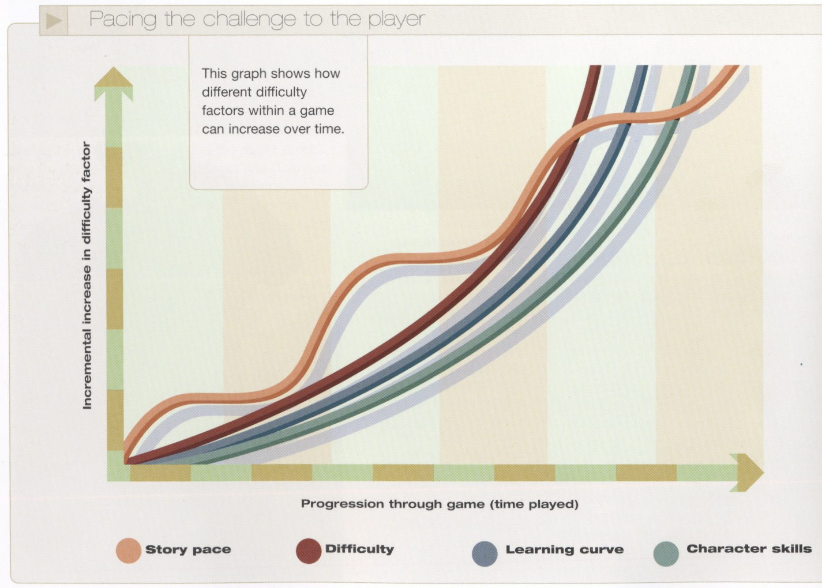
Difficulty Curves

Slide 22
Game Design Catchwords
Simplicity
When designing games, you could have a tendency to
over-complicate your games (even with good intentions)
This applies to the game play, game logics, and also the
interface design.
Consistency
Players will believe in any type of behavior in a game world no
matter how ridiculous it could be, so long as it is consistent.

Slide 23
II. The Design Process
Making up your initial idea
Expanding your initial idea
Summarizing your idea
Developing your idea
Documenting your idea

Slide 24
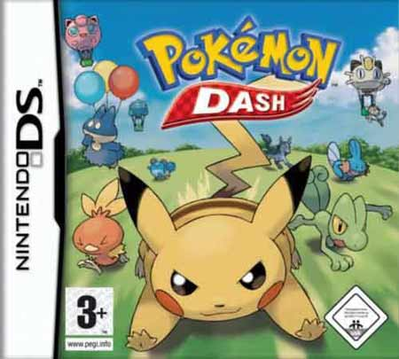
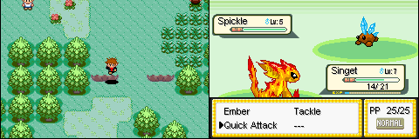
(1) Making up your initial idea
Sources to make up the initial spark
1. Existing Intellectual Property (IP)
- Some games come from an existing idea, including films,
TV, comics, sports, or even existing computer games
- E.g., Pokemon, etc.

Slide 25
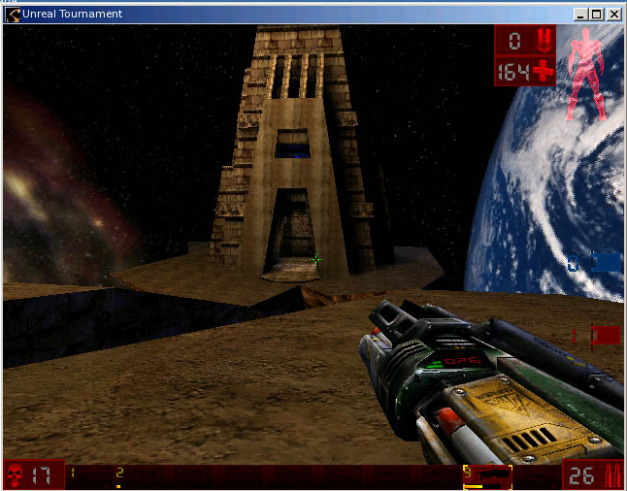
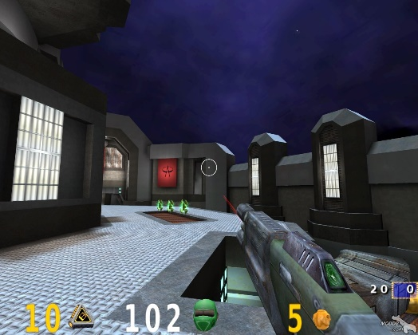
(1) Making up your initial idea
Similar theme (‘me too’ products)
- If company A has a successful game, company B might
direct its game designers to make a similar product; but
need to have enough difference to avoid copyright problem
- E.g., Unreal Tournament and Quake 3 (released
within days) – both are FPS + multiplayer
Unreal
Tournament
Quake 3

Slide 26
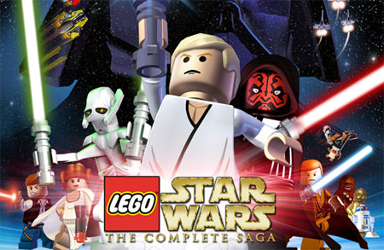
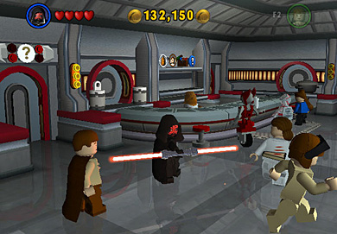
(1) Making up your initial idea
3. Mix and Match
- These ideas come from the “What if” question?
- Transposition of one story into a different age or setting
- For example, Lego Star Wars – play through a popular
story using Lego miniatures, etc.

Slide 27
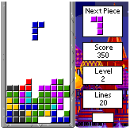
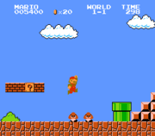
(1) Making up your initial idea
4. Brand new idea
- Rarest and riskiest (for industry but not for this class!)
- Good examples: Tetris and Mario Bros.
- Creativity and breakthrough are the keys

Slide 28
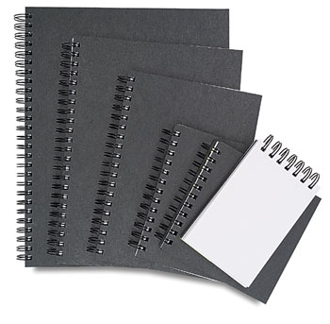
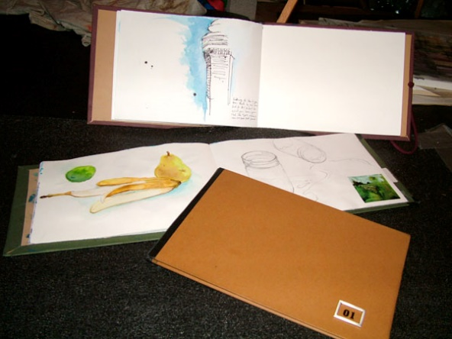
(2) Expanding your idea
Cultivating Inspiration
Exposure to wide range of experience: literature, art, philosophy, history, films, TV, etc.
Sketchbooks and notebooks
It is a good practice for designers to have their own sketchbooks or notebooks to regularly document (in the form of sketch, photos, movies, etc.) whatever they encountered and thought of

Slide 29


(2) Expanding your idea
3. Game Development conferences:
Game Developers Conference (GDC): http://www.gdconf.com/
Independent games festival (IGF): by independent game developers
working on smaller-scale games mainly on web browsers, PCs, or
mobile phones http://www.igf.com

Slide 30


(2) Expanding your idea
Look for similar games
Unless you have a unique and brand-new idea, there should be similar games for you to compare: game theme, game mechanics, etc.
Search for the related game review comment; learn from it and avoid the problems in previous games
Look at the Internet
Wikipedia, google, etc. to broaden your knowledge related to your initial idea

Slide 31
(3) Summarizing your idea
Important questions to answer:
Can you describe your game concisely in one paragraph?
Highlight the Premise of your game (important: games without an early version), any unique feature, and its potential in the market
2. Can you summarize the story?
A short paragraph capturing the essence of the storyline and allows to understand how to
Example? Film summary.
Which platform?
Unless using a multiplatform engine (e.g., WebGL), try not to stretch your game to fit everything at the beginning

Slide 32







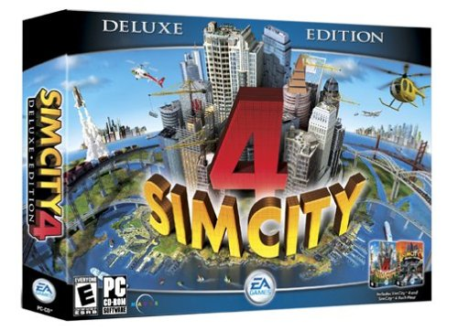
(3) Summarizing your idea
4. What is the target audience?
Age range? Personality?
Entertainment Software Rating Board (ESRB): http://www.esrb.org/
A non-profit organization – assign international ratings to software
This affects the kinds of contents you can put in your software:
The presentation style? Cartoon? Realistic? Level of violence?
5. What is the game category?
See previous lecture notes

Slide 33

(4) Developing your idea
After you make up your initial game design, next step is to
consider the detail: research and gather material
Game design sites:
www.gamasutra.com

Slide 34
(4) Developing your idea
2. Gathering related material
Taking photos yourselves
Gathering images and animations from the Internet
Good for designing textures, game characters, and environments in the game space
Keep references
For material you have gathered (e.g., photos, animations, design ideas, game review, etc.), it is a good practice to make the references: where you get them
This is not only good for maintenance, but also for you to re-search those places in the future

Slide 35
(4) Developing your idea
4. Detailed designs
Character design: appearance, behavior, etc.
Environment design: texture, lighting, scale, objects, etc.
Level design:
Subdividing the story and objectives in each level
Document: Maps, timing, flowcharts, etc.
User interface design and User Interaction:
Organize the screen: play area, map, information, etc.
Input and feedback: Keyboard, joystick, mouse, joypad, etc.
Audio and Music design
Game physics and AI needed in your game
Algorithms to animate and control objects

Slide 36
(5) Documenting your idea
Basic rules:
Be concise and accurate
Clearly state the overall integrated design
Cover all major issues: game play, game world, etc. (see next slide)
Do not promise what you cannot deliver
Proofreading: Check spelling and grammar

Slide 37
(5) Documenting your idea
In game design, we have Game Design Document (GDD) -
It is a detailed design specification:
Front section: game name, company name, game category, platform, target age group, date, etc.
Story synopsis: a short breakdown of the story
Artwork: visual appearance – game characters, world, etc.
Game design: objective, game mechanics, controls, interface design, character movement, etc.

Slide 38
III. The Design Production
Organize resources
Implementation Priority: Minimax
The Development Plan
Prototyping
Work out the Plan
Game Test and Game Deployment
Game Maintenance

Slide 39
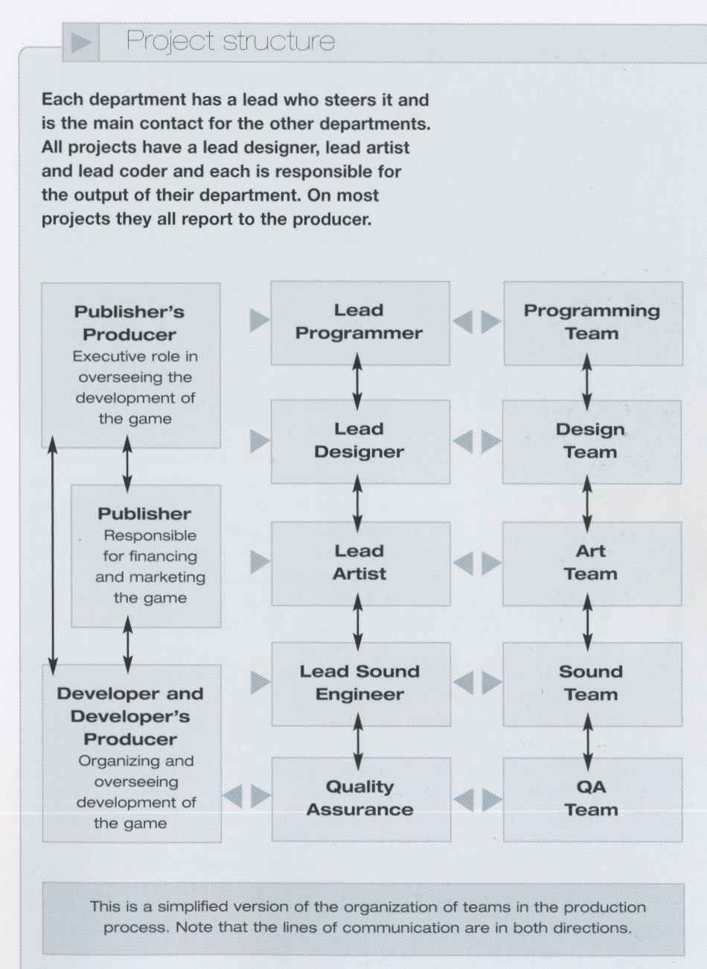
(1) Organize Resources
Decide:
Human resources
Who’s involved? (next slide)
Development tools
Modeling tools, e.g., Maya, etc.
Texture tools, e.g., Photoshop, etc.
Audio tools
General Programming tools
3D Graphics programming API

Slide 40
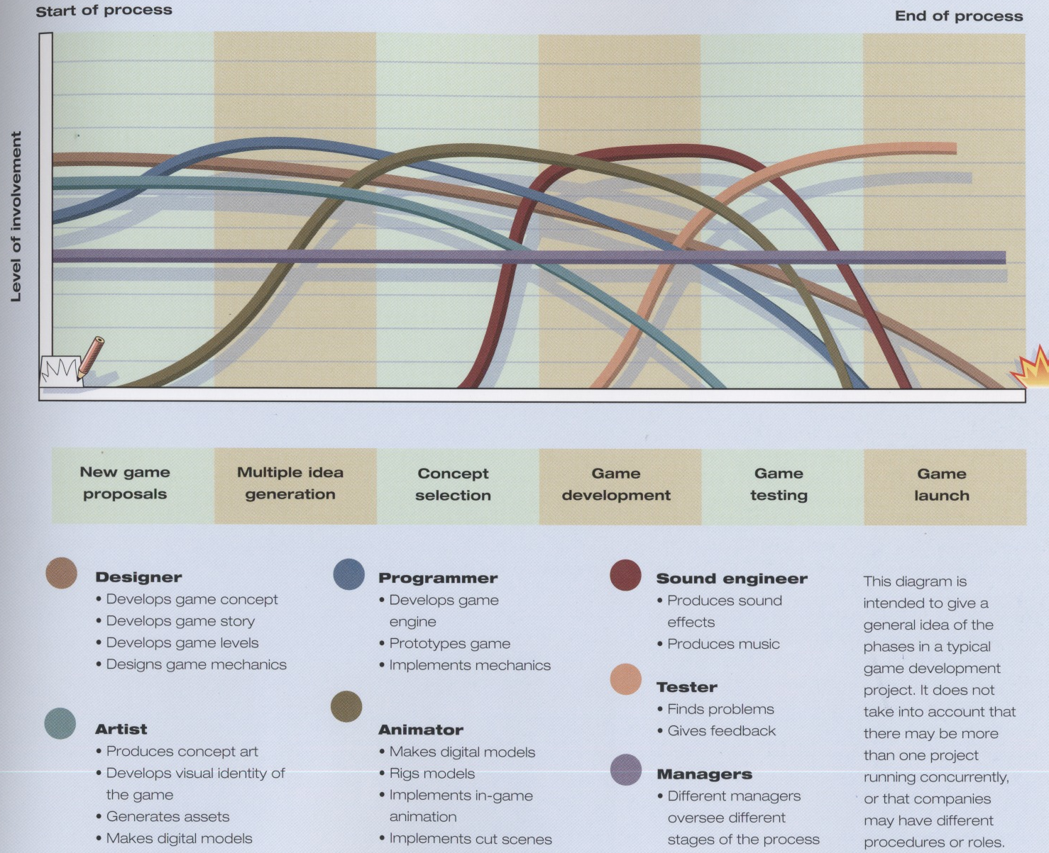

Slide 41
(2) Implementation Priority: Minimax
Assign the game features into the matrix
Decide feature sets in implementation priority
Benefit
min
max
Best
solution
min
Cost
Worst
solution
max

Slide 42
(2) Implementation Priority: Minimax
Minimin: not important to player, easy to code
e.g. birds in a 3D adventure game
Maximin: little benefits but hard to code
e.g. the driver in racing cars
Minimax: simple to code but add a lot to player experience
e.g. different parameters of RPG characters.
Maximax: hard to code and define gameplay experience
e.g. outdoor renderer for a flight simulator

Slide 43
(3) The Development Plan
Make up the development plan
Gantt chart
Task breakdown and task responsibility
Milestones

Slide 44
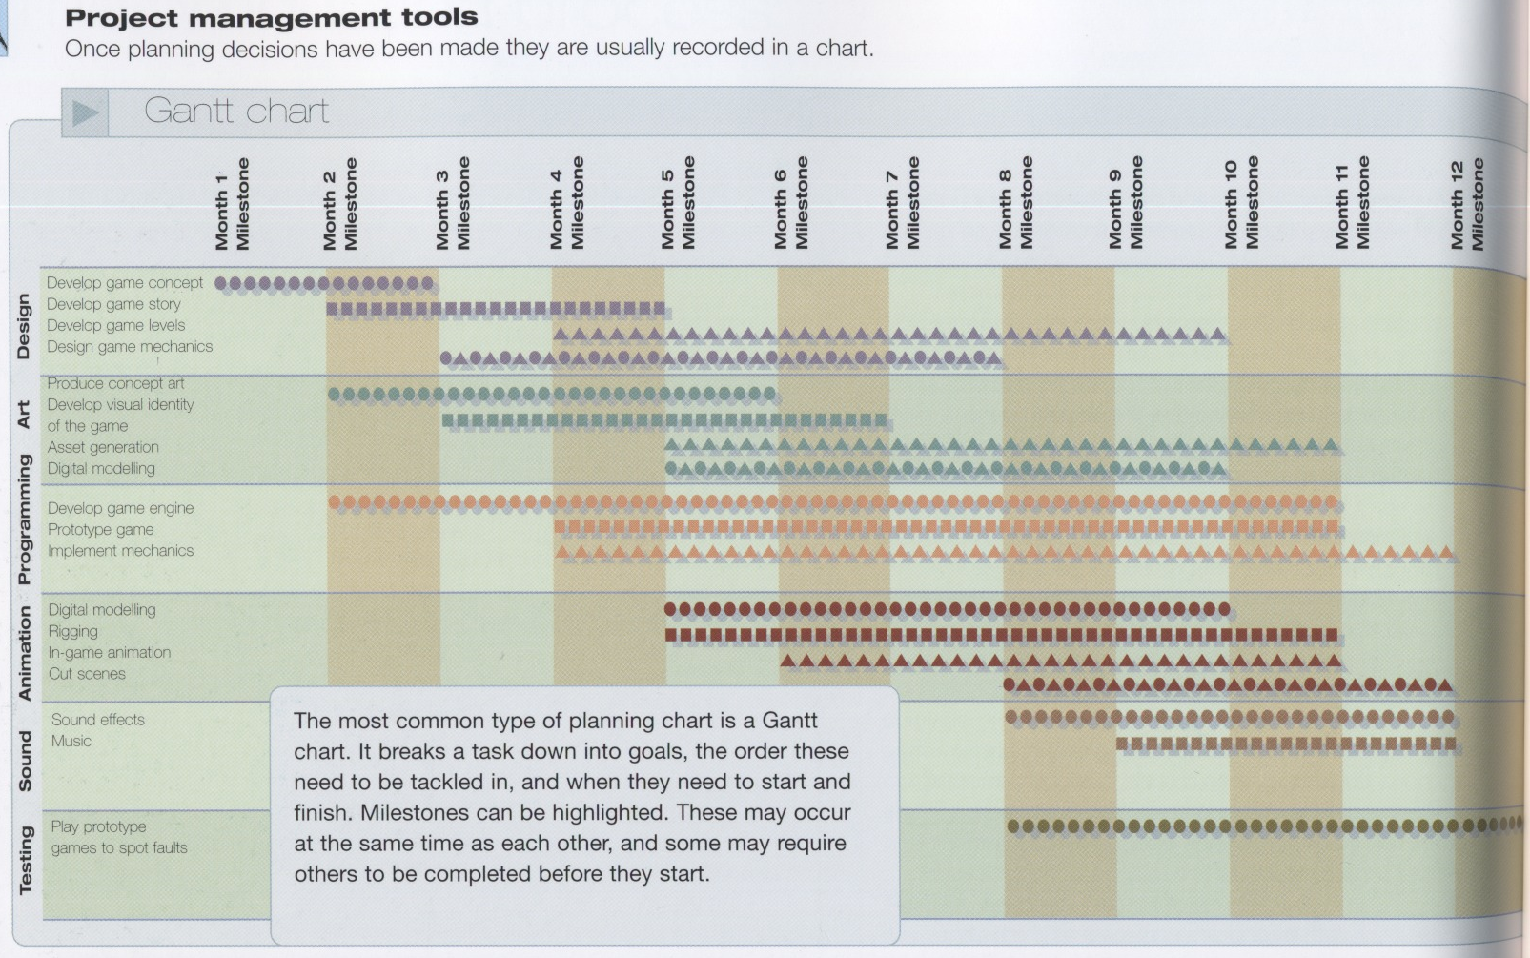

Slide 45
(4) Prototyping your game
Prototyping = Creating a portion of your game to test your ideas
Good for communication, e.g., a puzzle game like Tetris
would be hard to communicate through paper work
Rules in making prototype:
Focus on the core game mechanics such
as main features and game character actions
Keep it simple; leave the artwork (pictures,
textures, 3D models, animations, etc.)
unless really necessary

Slide 46
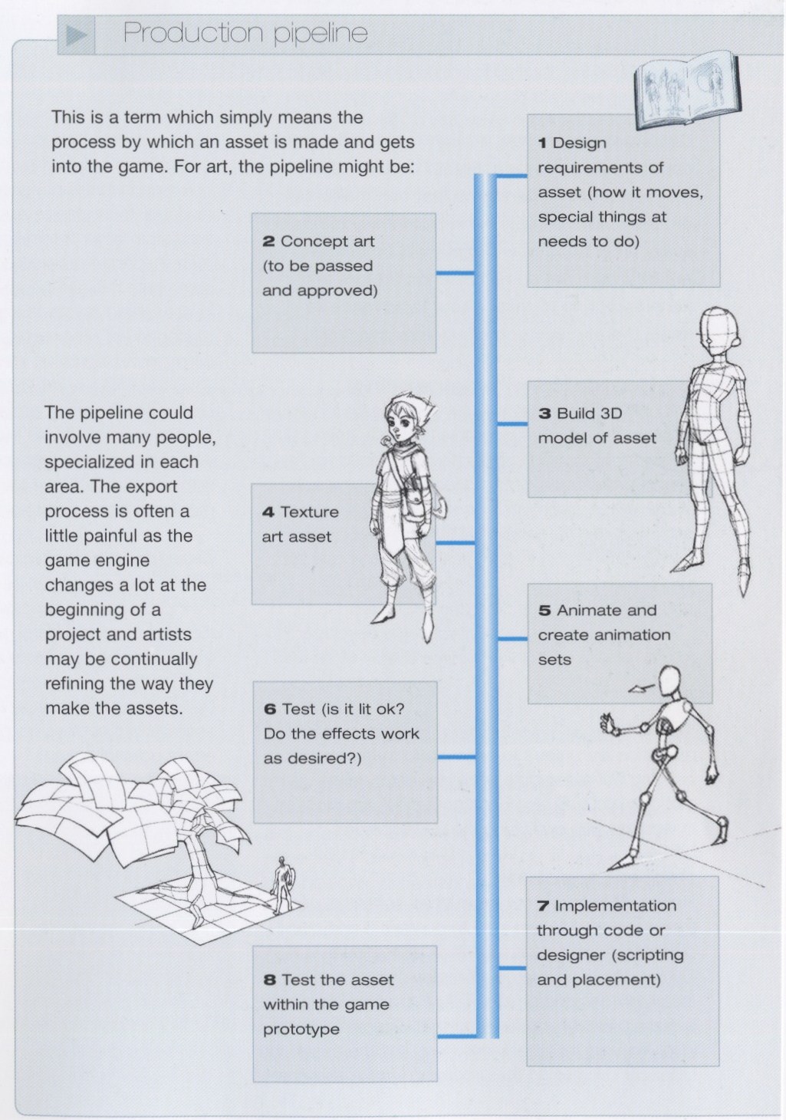
(5) Work out the Plan
Production Pipeline
Game Design
3D modeling
Texture
Animation
Unit test
Implementation: coding
Test within game prototype
MISC: Audio, network, etc.

Slide 47
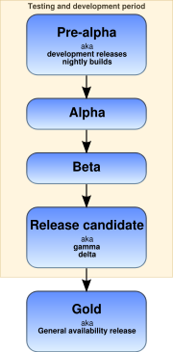
(6) Game Test and Deployment
Game Test
Quality Assurance Team
Look for bugs, inconsistency in games, difficulty in games, anywhere in the game that game players can cheat, etc.
Software Release Stages:
Pre-alpha: under development
Alpha: delivered to software testers
Beta: first version released outside the organization that develops the software
Release

Slide 48
(7) Game Maintenance
Games usually have short shelf life except online games
Network games different in that lots of content is created after release, e.g., extending the map, expansion set, etc.
Both needs maintenance to extend the shelf life
Can build fans community & thus increase the life span
Support including: patches – bug fixing, editing tools - mod community, additional missions

Slide 49
Summary:
The Design Theory
- Learn this before making up your idea
II. The Design Process
- Make up your idea
The Design Production
- Realize your idea
Prepare your game proposal using the techniques
you learnt in this part of the course

Slide 50
Planning your game
February
3 | 10 | 17 | 24
5 | 12 |  | 26
Brainstorming (moved to 12)
Proposal

